Slide 1
Objectives
In this session, you will learn to:
  Identify various classes of a portable computer
  Identify the components of the system unit
Notes:
Students have learnt the structure of different types of dimensions and the importance of surrogate keys in Module I. In this session, students will learn to load the data into the dimension tables after the data has been transformed in the transformation phase. In addition, students will also learn to update data into these dimension tables.
Students already know about different types of dimension tables. Therefore, you can start the session by recapitulating the concepts. Initiate the class by asking the following questions:
1. What are the different types of dimensions?
2. Define flat dimension.
3. What are conformed dimension?
4. Define large dimension.
5. Define small dimension.
6. What is the importance of surrogate key in a dimension table?
Students will learn the loading and update strategies theoretically in this session. The demonstration to load and update the data in the dimension table will be covered in next session.

Slide 2

Introducing Classes of Portable Computers
How many types of personal computers (PC) are there?

Slide 3
Introducing Classes of Portable Computers (Contd.)
There are two types of personal computers. They are desktop computers and portable computers.

Slide 4
Introducing Classes of Portable Computers (Contd.)
  Desktop computers:
  Are designed to fit easily on the top of a typical desk.
  Consist of several components that are connected together.
  Cannot be carried along while traveling.
  Portable computers:
  Are designed to be small and lightweight.
  Can be carried along and used while traveling.

Slide 5
Characteristics of Portable Computers
The size of a portable computer can be reduced by:
  Using Liquid Crystal Display (LCD). It is light weight and consume very less power.
  Reducing the number of keys on the keyboard. The keys are made to perform multiple functions.
  Reducing the size of hard disk.
  Using the power-conserving microprocessors.

Slide 6
Classes of Portable Computers
Classes of portables:
  Laptop
  Palmtop
  PDA

Slide 7
Classes of Portable Computers (Contd.)
  Laptop:
  Is small, slim, and lightweight portable computer.
  Has same capabilities as that of desktop computers.
  Uses a reduced keyboard and mouse as input devices.
  Is bulky as compared to notebooks.
  IBM ThinkPad, Acer, and Lenovo are few examples of laptop.

Slide 8
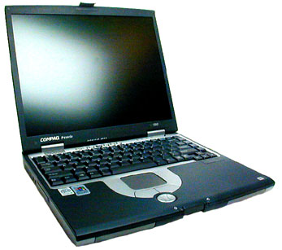
Classes of Portable Computers (Contd.)
Let us see a Laptop.

Slide 9
Classes of Portable Computers (Contd.)
  Palmtop:
  Is the smallest portables.
  Is less capable as compared to a PC.
  Is useful for data entry operations.
  BlackBerry 8700c, Hewlett-Packard's 200LX, and Toshiba's e755 are few examples of palmtop.

Slide 10
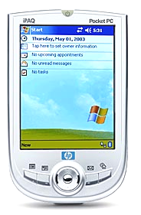
Classes of Portable Computers (Contd.)
Let us see a palmtop.

Slide 11
Classes of Portable Computers (Contd.)
  PDA:
  Is a handheld computing device.
  Allows I/O operations on data.
  Contains at least one database to store information.
  Supports networking, wireless communication, voice recording, and telephone/fax integration.
  Apple Newton and Casio Cassiopeia are few examples of PDA.

Slide 12

Classes of Portable Computers (Contd.)
Let us see a PDA.

Slide 13
Bluetooth Technology
Bluetooth technology:
  Is a wireless protocol.
  Is used to communicate from one device to another.
  Is used in a small area usually less than 30 feet.
  Is a wireless, low-cost radio solution.
  Enables small devices such as PDAs, cell phones, and palmtops to communicate.
  Enables data connections between electronic devices.
  Is dependent on mobile devices with a chip for sending and receiving information.
  Is used in wireless headsets, mobile phones, handheld PCs, consumer electronics (such as cameras, VCRs, and walkman), and entertainment robots.

Slide 14
Introducing Components of the System Unit
What is a system unit?

Slide 15
Introducing Components of the System Unit (Contd.)
The system unit is a box-like unit. It consists of number of components. Each component performs a discrete function.

Slide 16
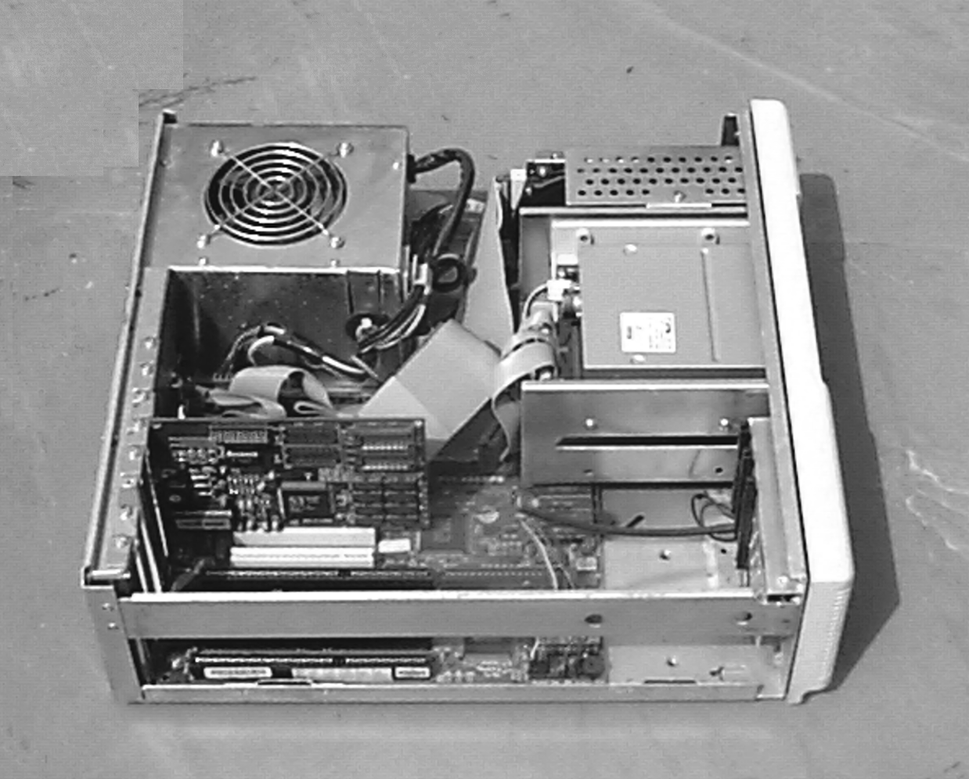
Introducing Components of the System Unit (Contd.)
The following figure displays various components of the system unit.
Fan and SMPS
Hard Disk Drive
Controller Cables
Floppy Disk Drive
Hard Disk and Floppy Disk Controller
Speaker
Motherboard

Slide 17
Introducing Components of the System Unit (Contd.)
Internal power supply:
  Is known as Switched Mode Power Supply (SMPS).
  Provides a cable connector.
  Provides the required voltage to the internal and external components.
  Converts the AC input into DC output of 5 and 12 volts.
  Contains the ON/OFF switch of the system unit.
Exhaust fan:
  Is a small fan within the SMPS unit.
  Rotates as long as the computer is switched on.
  Is used to provide cooling to the SMPS unit.

Slide 18
Introducing Components of the System Unit (Contd.)
Speaker:
  Is an output device.
  Is used to generate sound whenever instructed by the computer.
  Is connected to the motherboard.
Motherboard:
  Is a large board in the CPU.
  Contains number of tiny electronic circuits.
  Provides connection to all peripheral devices.

Slide 19
Introducing Components of the System Unit (Contd.)
  The components of the motherboard are:
  Chipset: It is a set of chips attached to the motherboard. It is used to enable communication between the processor and other components.
  Microprocessor: It is used to do the processing of a computer. It consists of:
    Arithmetic Logic Unit (ALU)
    Control Unit
    Registers
  Clock chip: It provides the timing signal in the form of electronic pulses. It is used by the computer components to set up a working pace.

Slide 20
Introducing Components of the System Unit (Contd.)
  Memory: It is present on the motherboard in the form of chips. The two types of memory are:
    Random Access Memory (RAM)
    Read Only Memory (ROM)
  Bus: It is a set of wires. It is use to communicate and transfer data between the microprocessor and the memory chips.
  Ports: They are the inlets and outlets of the microprocessor. All input and output devices connected to the system unit through ports. The microprocessor communicates with the external devices through them.

Slide 21
Introducing Components of the System Unit (Contd.)
Expansion slot:
  Is a set of sockets on the motherboard.
  Helps in attaching extra input and output devices to the computer.
  The three types of expansion slots are:
  Industry Standard Architecture (ISA)
  Peripheral Component Interconnect (PCI)
  Accelerated Graphics Port (AGP)

Slide 22
Summary
In this lesson, you learned that:
  The PC range includes desktops, laptops, notebooks, and palmtops.
  Bluetooth is a wireless protocol that is used to communicate from one device to another in a small area.
  Components of the system unit are:
    Power supply with exhaust fan
    Speaker
    Motherboard
    Disk drives
    Adaptor cards

Slide 23
Summary (Contd.)
  The motherboard contains various components like:
    Chipset
    Microprocessor- Popular microprocessors are Intel 8088, 80286, 80386, 80486, and Pentium
    Bus
    Ports

